Slide 1
Introduction to Data Analysis

Slide 2
DATA COLLECTION & DATA MANAGEMENT
Patrick Boily Data Action Lab | uOttawa | Idlewyld Analytics
pboily@uottawa.ca
[with files from Jen Schellinck | Sysabee]

Slide 3
OBJECTIVE
We seek data that can:
provide legitimate insight into our system of interest;
provide correct, accurate answers to relevant questions;
support the drawing of valid conclusions, with the ability to qualify/quantify these conclusions in terms of scope and precision.
This cannot be done without study design: what data should we cllect, and how should we collect it.

Slide 4
Data Sources
DATA COLLECTION AND DATA MANAGEMENT

Slide 5
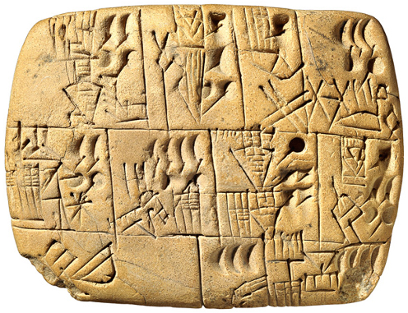
FUNDAMENTAL QUESTIONS
Why do we collect data? What can we do with data?
Where does data come from?
What does ‘a collection’ of data look like? How could it be described?
Do we need to distinguish between data, information, knowledge?

Slide 6

MOTIVATIONS FOR DATA COLLECTION
Three functions, historically:
record keeping (people/societal management)
science – new general knowledge
intelligence – business, military? police? social? domestic? personal?
Each of these three functions have traditionally used different sources of information.
they have collected different types of data
they also have different data cultures and terminologies

Slide 7
DATA CULTURES AND TERMS
Business Intelligence:
data warehouse + data mart
data 'dimension’ (= data set)
hierarchical data (slices)
data element
dimension table + fact table
Science/Statistics:
experimental data
trials
participants
variables
correlation
Record Management:
information architecture
file plan
information resource
field
form and subject
Data Science
Data
Knowledge
Information

Slide 8
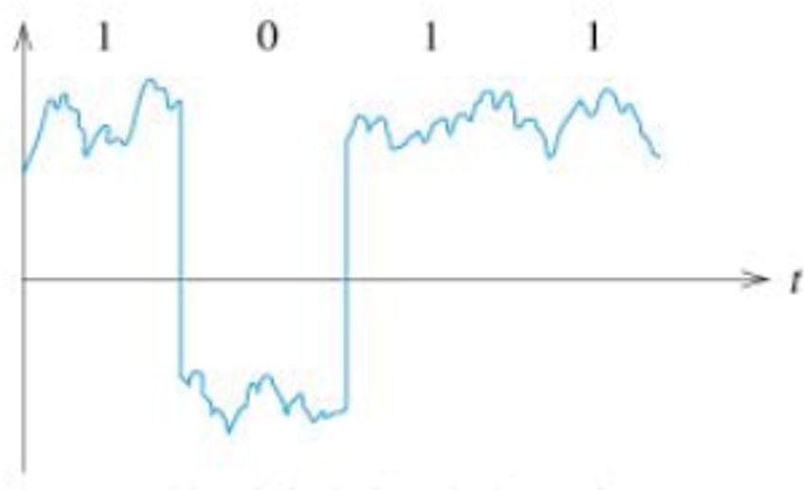
COMPUTERS AND DATA
Computer/information science has its own theoretical, fundamental viewpoint about data, and information.
Data becomes digital: computers operate over data in a fundamental sense – 1’s, 0’s representing numbers, letters, etc.
Pragmatically, data is now stored on computers, and is accessible through world-wide computer networks.

Slide 9

DATA IS REAL
Data is a representation, but data is still physical.
It has physical properties, it requires physical space & energy to work with it.

Slide 10

DATA DECAYS
Data ages over time – it has a shelf life.
We use the phrase “rotten data” or “decaying data”
literally – the data storage medium might decay
metaphorically – when the data no longer accurately represents the relevant objects and relationships or even when those objects no longer exist in the same way
Data must be kept ‘fresh’ and ‘current’, not ‘stale’ (context and model dependent!)

Slide 11
SAMPLING THEORY AND STUDY DESIGN
DATA COLLECTION AND DATA MANAGEMENT
“The latest survey shows that 3 out of 4 people make up 75% of the population”
D. Letterman

Slide 12
[G. Smith, The Exaggerated Promise of So-Called Unbiased Data Mining]
“A Dartmouth graduate student used an MRI machine to study the brain activity of a salmon as it was shown photographs and asked questions. The most interesting thing about the study was not that a salmon was studied, but that the salmon was dead. Yep, a dead salmon purchased at a local market was put into the MRI machine, and some patterns were discovered. There were inevitably patterns—and they were invariably meaningless.”

Slide 13
NPS AND PATTERN FISHING
Two separate issues can be combined to cause problems with data analysis:
drawing conclusions (inferences) from a sample about a population that are not warranted by the sample collection method (symptomatic of NPS);
looking for any available patterns in the data and then coming up with post hoc explanations for these patterns.
Alone or in combination, these lead to poor (and potentially harmful) conclusions.

Slide 14
STUDIES, SURVEYS, AND SAMPLING MODELS
A survey is any activity that collects information about characteristics of interest:
in an organized and methodical manner;
from some or all units of a population;
using well-defined concepts, methods, and procedures, and
compiles such information into a meaningful summary form.
A census is a survey where information is collected from all units of a population, whereas a sample survey uses only a fraction of the units.
When survey sampling is done properly, we may be able to use various statistical methods to make inferences about the target population by sampling a (comparatively) small number of units in the study population.

Slide 15
DECIDING FACTORS
Sometimes, information about the entire population is required in order to answer questions; at other times it is not necessary. The survey type depends on multiple factors:
the type of question that needs to be answered;
the required precision;
the cost of surveying a unit;
the time required to survey a unit;
size of the population under investigation, and
the prevalence of the attributes of interest.

Slide 16
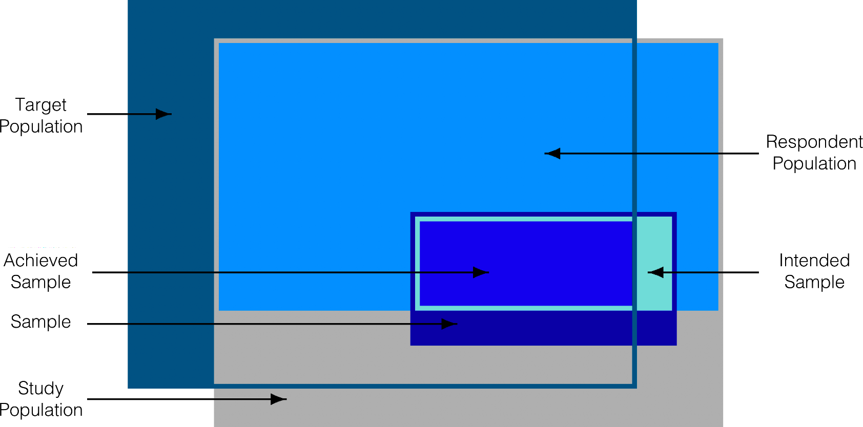
Target Population
RespondentPopulation
Achieved Population
Intended Sample
Sample
Study Population

Slide 17
STUDY/SURVEY STEPS
Surveys follow the same general steps:
statement of objective
selection of survey frame
sampling design
questionnaire design
data collection
data capture and coding
data processing and imputation
estimation
data analysis
dissemination
documentation
The process is not always linear, but there is a definite movement from objective to dissemination.

Slide 18
SURVEY FRAMES
The frame provides the means of identifying and contacting the units of the study population. It is generally costly to create and to maintain.
The ideal frame contains ID, contact, classification, maintenance, and linkage data. It must minimize the risk of under/over-coverage, as well as the number of duplications and misclassifications.
A statistical sampling approach is contraindicated unless the frame is
relevant (it corresponds, and permits accessibility to, the target population),
accurate (the information it contains is valid),
timely (it is up-to-date), and competitively priced.

Slide 19
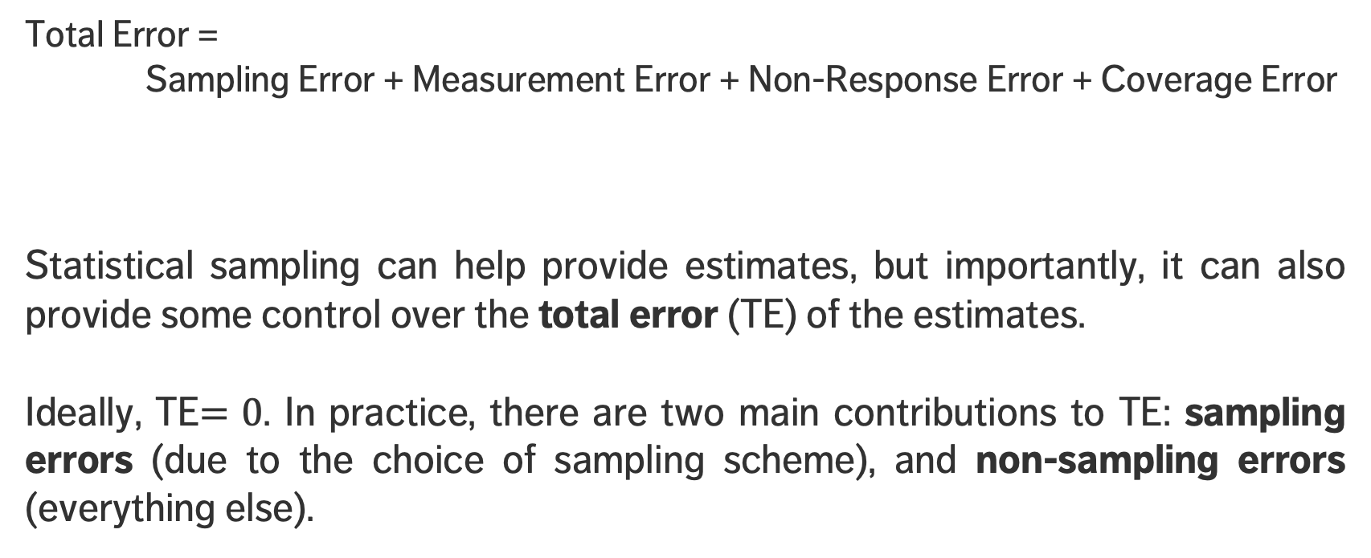
SURVEY ERROR
Total Error = Sampling Error + Measurement Error + Non-Response Error + Coverage Error
Statistical sampling can help provide estimates, but importantly, it can also provide some control over the total error (TE) of the estimates.
Ideally, TE$=0$. In practice, there are two main contributions to TE: sampling errors (due to the choice of sampling scheme), and non-sampling errors (everything else).
survey, not census
observations not measured accurately
non-respondents having systematic observation differences
frame decay and/or corruption

Slide 20
NON-SAMPLING ERROR
Non-sampling error can be controlled, to some extent:
coverage error can be minimized by selecting high quality, up-to-date frames;
non-response error can be minimized by careful choice of the data collection mode and questionnaire design, and by using “call-backs” and “follow-ups”;
measurement error can be minimized by careful questionnaire design, pre-testing of the measurement apparatus, and cross-validation of answers.
In practice, these suggestions are not that useful in modern times.
This explains, in part, the over-use of web scraping and non-probabilistic sampling.

Slide 21
NON-PROBABILISTIC SAMPLING
Nonprobabilistic sampling (NPS) methods (designs) select sampling units from the target population using subjective, non-random approaches.
NPS are quick, relatively inexpensive and convenient (no frame required).
NPS methods are ideal for exploratory analysis and survey development.
Unfortunately, NPS are often used instead of probabilistic designs (not good)
the associated selection bias makes NPS methods inferentially unsound;
automated data collection often fall squarely in the NPS camp – we can analyze data collected with a NPS approach, but not generalize the results to the target population.

Slide 22

NPS METHODS
There are contexts where NPS methods might fit a client’s or an organization’s need, but they must be informed of the drawbacks, and presented with some probabilistic alternatives.
Haphazard: person on the street, depends on availability of units, interviewer bias
Volunteer: self-selection bias
Judgement: biased by inaccurate preconceptions about the target population
Quota: exit polling, ignores non-response bias
Modified: starts probabilistic, switches to quota as a reaction to high non-response rates
Snowball: “pyramid” scheme
How could NPS methods work against collecting inclusive, representative data?

Slide 23
PROBABILISTIC SAMPLING
Probabilistic sample designs are usually more difficult and expensive to set-up (due to the need for a quality frame), and take longer to complete.
They provide reliable estimates for the attribute of interest and the sampling error, paving the way for small samples being used to draw inferences about larger target populations (in theory, at least; the non-sampling error components can still affect results and generalisation).

Slide 24
SAMPLING DESIGNS
Different sampling designs have distinct advantages and disadvantages.
They can be used to compute estimates
for various population attributes: mean, total, proportion, ratio, difference, etc.
for the corresponding 95% confidence intervals.
We might also want to compute sample sizes for a given error bound (an upper limit on the radius of the desired 95% CI), and how to determine the sample allocation (how many units to be sampled in various sub-population groups).

Slide 25
PROBABILISTIC SAMPLING DESIGNS
Simple random sampling (SRS)
Stratified random sampling (STS)
Systematic sampling (SYS)
Cluster sampling (CLS)
Probability proportional-to-size sampling (PPS)
Replicated sampling (RES)
Multi-stage sampling (MSS)
Multi-phase sampling (MPS)

Slide 26
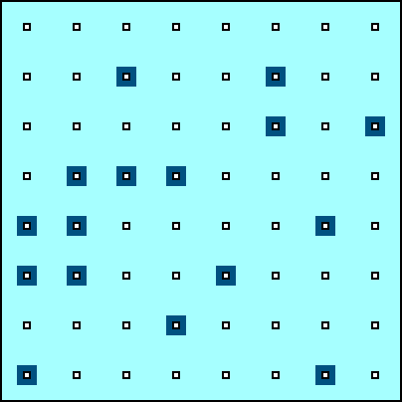
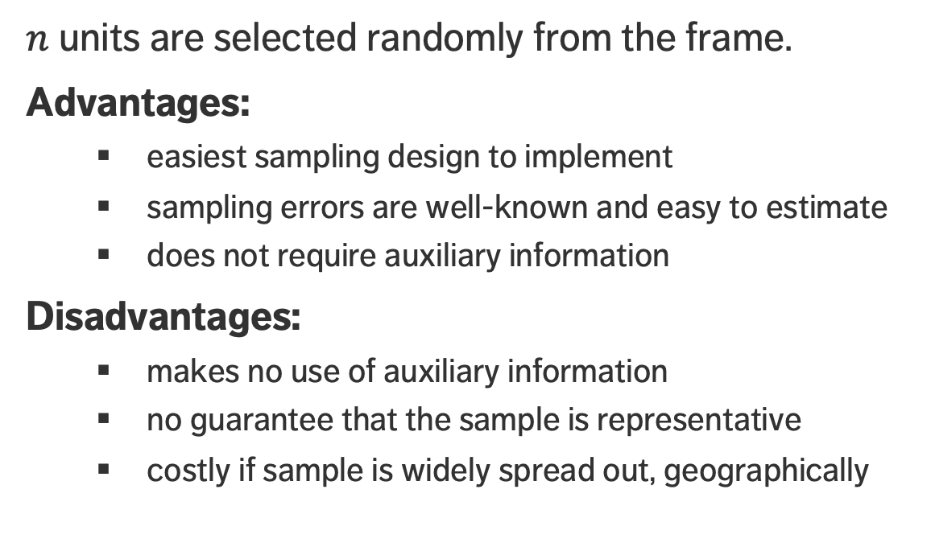
SIMPLE RANDOM SAMPLING (SRS)
$n$ units are selected randomly from the frame.
Advantages:
easiest sampling design to implement
sampling errors are well-known and easy to estimate
does not require auxiliary information
Disadvantages:
makes no use of auxiliary information
no guarantee that the sample is representative
costly if sample is widely spread out, geographically

Slide 27
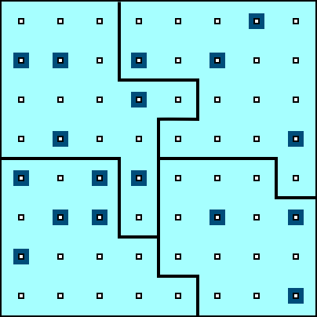
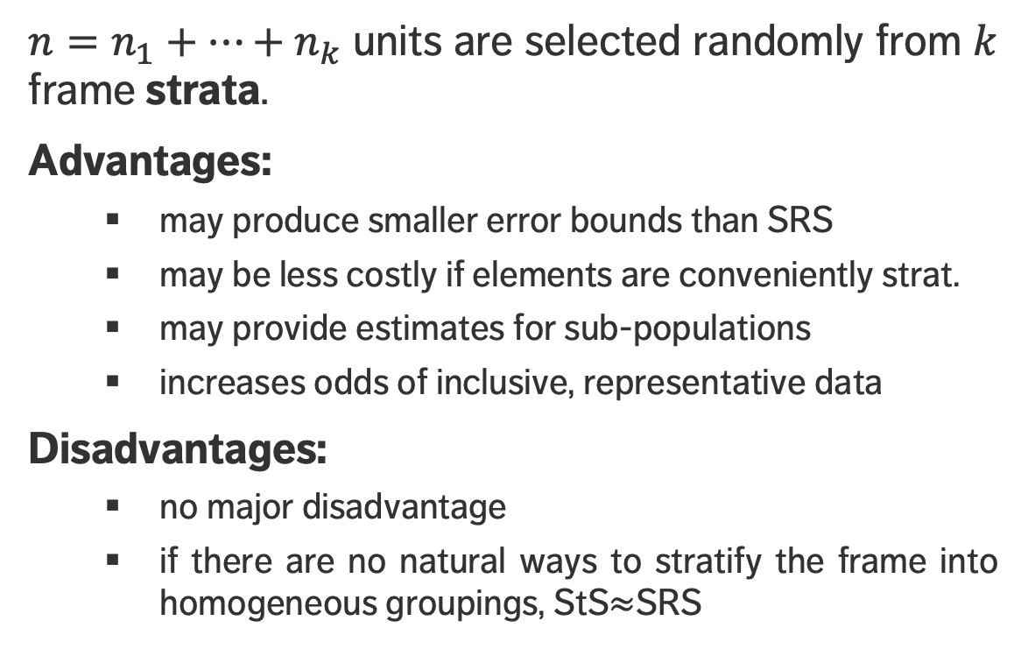
STRATIFIED RANDOM SAMPLING (StS)
$n=n_{1}+⋯+n_{k}$ units are selected randomly from $k$ frame strata.
Advantages:
may produce smaller error bounds than SRS
may be less costly if elements are conveniently strat.
may provide estimates for sub-populations
increases odds of inclusive, representative data
Disadvantages:
no major disadvantage
if there are no natural ways to stratify the frame into homogeneous groupings, StS$≈$SRS

Slide 28
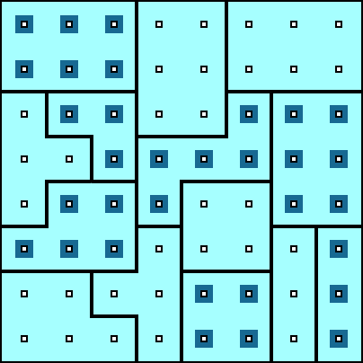
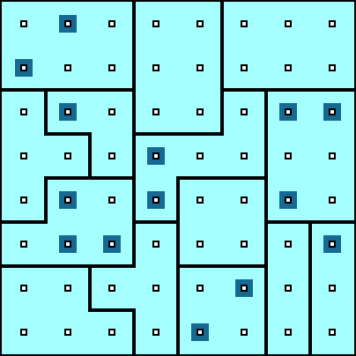
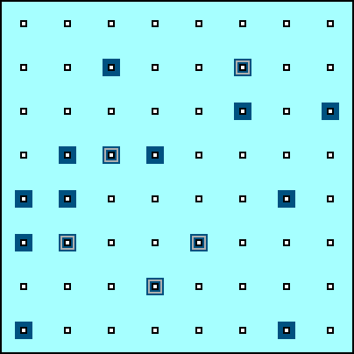
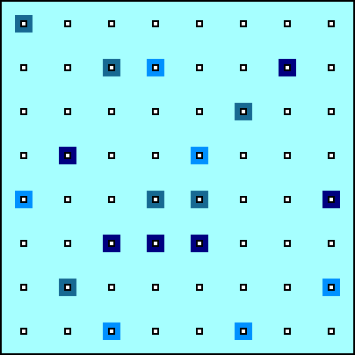
OTHER SAMPLING DESIGNS
Cluster Sampling (ClS)
Multi-Stage Sampling (MSS)
Multi-Phase Sampling (MPS)
Replicated Sampling (ReS)

Slide 29
WEB SCRAPING & AUTOMATED DATA COLLECTION
DATA COLLECTION AND DATA PROCESSING
“The streets of the Web are paved with data that can’t wait to be collected.”
Munzart, Rubba, Meissner, Nyhuis, Automated Data Collection with R

Slide 30
WORLD WIDE WEB
The way we share, collect, and publish data has changed over the past few years due to the ubiquity of the World Wide Web (WWW).
Private businesses, government, and individual users are posting and sharing all kinds of data and information.
At every moment, new channels generate vast amounts of data on human behaviour.

Slide 31
WORLD WIDE WEB
There was a time in the recent past where both scarcity and inaccessibility of data was a problem for researchers and decision-makers. That is emphatically not the case anymore.
Data abundance carries its own set of problems:
tangled masses of data
traditional data collection methods and classical (small) data analysis techniques may not be sufficient anymore

Slide 32
WEB DATA SCRAPING EXAMPLE: NEW PHONE
Let’s say you want to know what people think of a new phone. Standard approach: market research (e.g. telephone survey, reward system, etc.).
Pitfalls:
unrepresentative sample: the selected sample might not represent the intended population
systematic non-response: people who don’t like phone surveys might be less (or more) likely to dislike the new phone
coverage error: people without a landline can’t be reached, say
measurement error: are the survey questions providing suitable info for the problem at hand?

Slide 33
WEB DATA SCRAPING EXAMPLE: NEW PHONE
These solutions can be costly, time-consuming, ineffective.
Proxies are indicators that are strongly related to the information of interest, without measuring it directly.
If popularity is defined as large groups of people preferring one product over a competitor, then sales statistics on a commercial website may provide a proxy for popularity.
Rankings on Amazon could provide a more comprehensive view of the phone market than a traditional survey.

Slide 34
WEB DATA SCRAPING EXAMPLE: NEW PHONE
Representativeness of the listed products
are all phones listed?
if not, is it because that website doesn’t sell them?
is there some other reason?
Representativeness of the customers
are there specific groups buying/not-buying online products?
are there specific groups buying from specific sites?
are there specific groups leaving/not-leaving reviews?
Truthfulness of customers and reliability of reviews.

Slide 35
AUTOMATED DATA COLLECTION CHECKLIST
With regards to social scientific data:
sparse financial resources
little time or desire to collect data by hand
want to work with up to date, high-quality data sources
document process from data collection to publication for reproducibility
Issues with manual collection:
non-reproducible process
prone to errors and cumbersome
subject to heightened risks of “death by boredom”
Advantages:
reliability
reproducibility
time-efficient
higher quality datasets

Slide 36
AUTOMATED DATA COLLECTION CHECKLIST
Is web scraping really necessary?
Criteria:
do you plan to repeat the task from time to time e.g. to update your database?
do you want others to be able to replicate your data collection process?
do you deal with online sources of data frequently?
is the task non-trivial in terms of scope and complexity?
if the task can be done manually, do you lack the resources to let others do the work?
are you willing to automate the process by means of programming?
If most answers are “Yes”, then automated collection may be the right choice.

Slide 37
DATA COLLECTION PROCESS
GAC example: collecting data at mission from social media to see trends in local opinion.
1. Know exactly what kind of information you need
Specific: sales of top 10 shoe brands in 2017
Vague: people’s opinion on shoe brand X
2. Find web data sources that could provide direct/indirect information
Easier for specific facts: shoe store’s webpage provides information about shoes that are currently in demand, such as sandals, boots, etc.
Tweets may contain opinion trends on anything
Commercial platforms can provide information on product satisfaction

Slide 38
DATA COLLECTION PROCESS
3. Develop a theory data generation processes for potential sources
When was the data generated?
When was it uploaded to the Web?
Who uploaded the data?
Are there any potential areas that are not covered? consistent? accurate?
How often is the data updated?

Slide 39
DATA COLLECTION PROCESS
4. Balance advantages and disadvantages of potential data sources
Validate the quality of data used
Are there independent sources that provide similar information?
Can you identify original source of secondary data?
5. Make a decision
Choose data source that seems most suitable
Document reasons for this decision
Collect data from several sources to validate data sources

Slide 40
DATA QUALITY
Questions:
what type of data is most suited to answer the questions?
is the quality of the data sufficiently high to answer the questions?
is the information systematically flawed?
is the data being used because “it’s the best data we have”?
Data quality depends on the application.
a sample of tweets collected on a random day could be used to analyze the use of a hashtags or the gender-specific use of words
not as useful if collected during Game 7 of the Stanley Cup Finals (collection bias)

Slide 41
WEB SCRAPING DATA QUALITY
First-hand information: for example, a tweet, or a news article.
Second-hand data: data that has been copied from an offline source or scraped from elsewhere.
Sometimes one can’t remember or retrace the source of such data.
Does it still make sense to use it? It depends.
Any use of secondary data requires cross-checking and validation.

Slide 42
WEB SCRAPING LEGALITY
What is a spider?
Programs that graze or crawl the web for information rapidly
Jumps from one page to another, grabbing the entire page content
Web scraping requires taking specific information from specific websites (which is the stated goal): how is that different from a spider?
“Scraping inherently involves copying, and therefore one of the most obvious claims against scrapers is copyright infringement.”

Slide 43
WEB SCRAPING LEGALITY
Crawling another company’s information to process and resell it is a common complaint.
Ethical Guidelines:
work as transparently as possible
document data sources at all time
give credit to those who originally collected and published the data
if the data is collected by another agency, get permission to reproduce it
don’t do anything illegal
Notes:
t.

Slide 44
Data And Knowledge Modeling
DATA COLLECTION AND DATA MANAGEMENT

Slide 45
CONTEXTUAL METADATA
Something is lost when we move from conceptual models to either a data or a knowledge model.
One way of keeping the context is to provide rich metadata – data about the data.
Metadata is crucial when it comes to carrying out strategies for working across datasets.
Ontologies can also play a role here.

Slide 46

STRUCTURED/UNSTRUCTURED DATA
A major motivator for new developments in database types and other data storing strategies is the increasing availability of unstructured data and 'blob' data:
structured data: labeled, organized, discrete structure is constrained and pre-defined
unstructured data: not organized, no specific pre-defined structure data model (text)
blob data: Binary Large Object (BLOb) – images, audio, multi-media

Slide 47
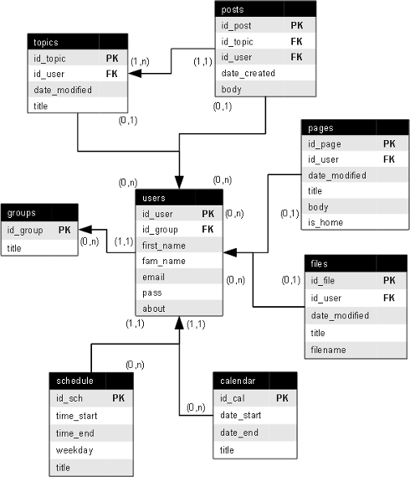
RELATIONAL DATABASES
Data is stored in a series of tables.
Broadly speaking, each table represents an object and some properties related to this object.
Special columns in the tables connect object instances across tables (allowing for merges).
The traditional approach to data storage.

Slide 48
STORES AND DATABASES
Relational Database:
widely supported, well understood, works well for many types of systems and use cases, difficult to change once implemented, doesn't deal with relationships well
Key-Value Stores:
can take any sort of data, no need to know much about its structure in advance, missing values don’t take up space, can get messy, difficult to find specific data
Graph Databases:
fast and intuitive for heavily relation-based data, might be the only option in this case as traditional databases may slow to a crawl, probably overkill in other cases, not yet widely supported

Slide 49
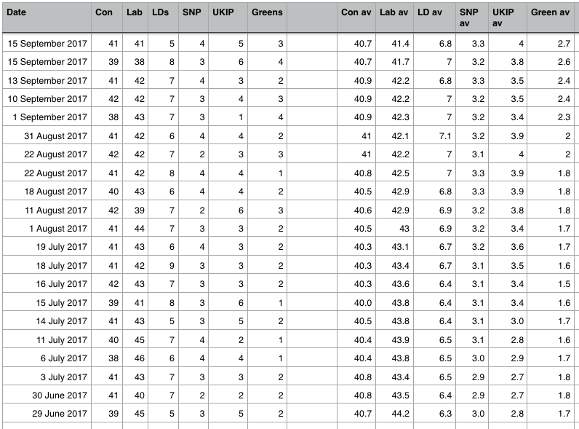
FLAT FILES AND SPREADSHEETS
What about keeping data in a single giant table (spreadsheet)?
Or multiple spreadsheets?
How bad can it be?
Wayne Eckerson coined the term ‘spreadmart’ to describe a situation with many (ad hoc) spreadsheets as a data strategy.

Slide 50
FLAT FILES AND SPREADSHEETS
Pros:
very efficient if collecting data only once, about one particular type of object
some types of analysis require all the data in one place
easy to read into analysis software and do operations over the entire dataset
Cons:
very hard to manage data integrity if continually collecting data
not ideal for system data involving multiples types of objects and relationships
can be very difficult to carry out data querying operations

Slide 51
DATABASE MANAGEMENT
Once data has been collected, it must also be managed.
Fundamentally, this means that the database must be maintained, so that the data is
accurate,
precise,
consistent
complete
Don’t let your data lake turn into a data swamp!

